Slide 1
Life History Parameters
Jeff Kipp
ASMFC Mock Data Workshop
Week 2: March 22, 2023

Slide 2
Outline
Week 2: Life History Parameters
Data
Overall purpose
Morphometric relationships
Growth
Maturity and reproductive capacity
Natural Mortality
Stock ID
Project: Life History

Slide 3
Data
Life history studies
Tagging programs
Survey biosampling
Fishery removals
Population structure
Life history characteristics

Slide 4
Data
Types of data
Length * Fecundity
Weight * Stomach contents
Age * Movement/migration
Maturity * Genetics
Sex * Sex change
Some data should be collected annually, some only need to be collected periodically

Slide 5
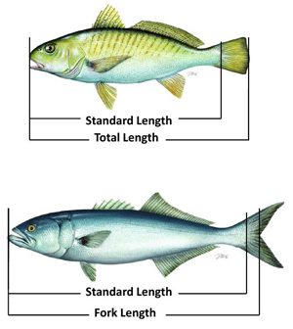
Length and Weight
Type
Length: fork or centerline, standard, total, carapace
Weight: hole, gutted, head off
Units and precision
Metric, non-metric

Slide 6
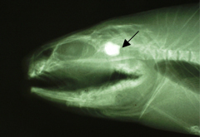
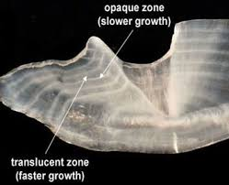
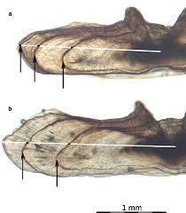
Age
Typically estimated from a hard part (otolith, scale, operculum)
Annuli
Hard part margins

Slide 7
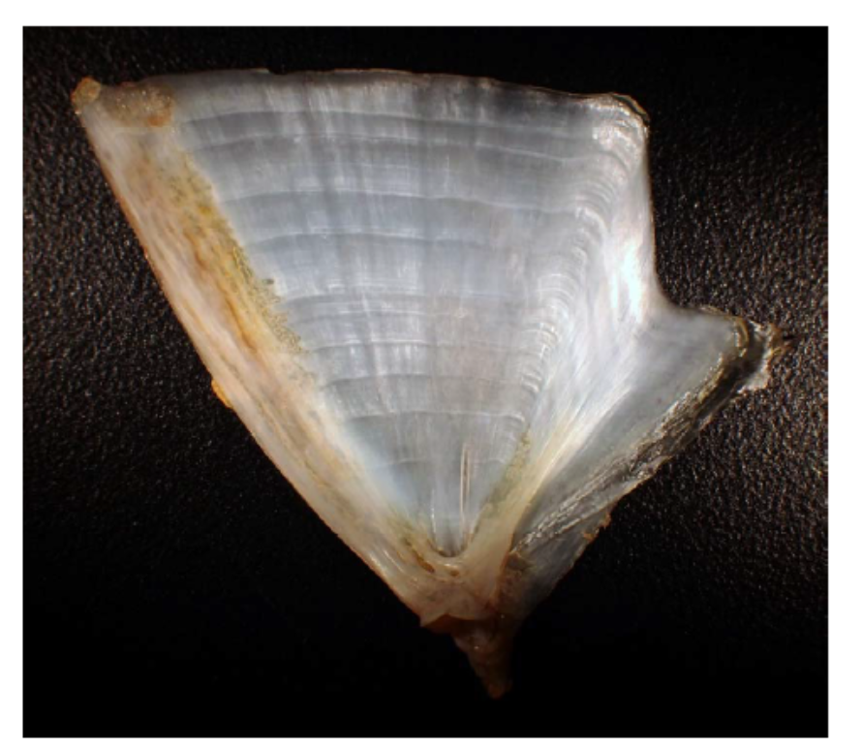
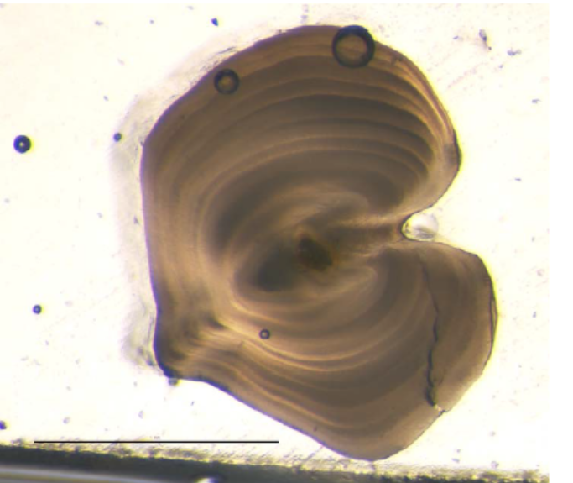
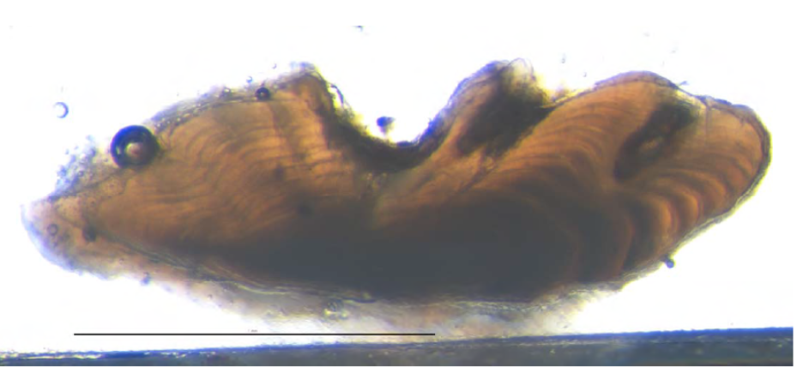
Ageing error
Studies conducted to estimate ageing error
Validate age structure
Quantify error within ager, among agers
This information can be incorporated into models
Campana 2001
http://www.asmfc.org/fisheries-science/research#Ageing

Slide 8
Age
Do ageing error studies indicate age data are useful?
Is everyone using the same methods?
Have methods changed over time?
E.g., scales to otoliths
What do the age data represent?

Slide 9
Maturity
How was the determination made?
Macroscopic or histological
Classification?
Brown-Peterson et al. 2011

Slide 10
Uses for Life History Data
Stock ID
Growth
Natural mortality
Maturity ogive
Morphometric conversions
Catch age compositions
Differences in life history between sexes
Sex transitions
Fecundity ogive
Predator-prey relationships
Migration

Slide 11
At the Data Workshop
You will be working with data from multiple different programs and agencies
Data collection may not be standardized across sources
Pay attention to metadata:
Units (cm, mm, in, kg, lbs)
Measurement types (fork length vs. total length, dressed weight vs. live weight)

Slide 12
Simple Evaluations
Plot your data!!
Magnitudes, Units ...do they ‘look right’
“In the ball park”
Outliers, data gaps
Temporal or spatial patterns
Discrepancies between data sources
Time to catch major omissions, extraction issues
Starting to understand the data before being used in life history analyses

Slide 13
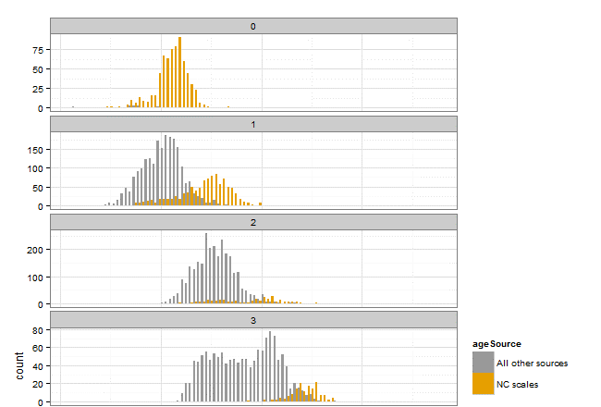
Simple Evaluations
Bluefish: historical NC data were not using the Jan. 1 birthdate

Slide 14
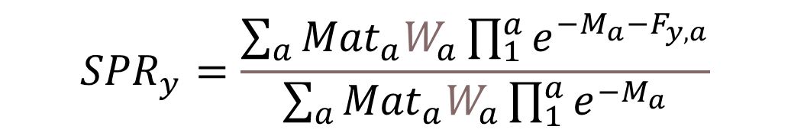
Life History Parameters
What are the biological characteristics of a stock and how do these characteristics change over the lifetime of an individual?
How productive is the stock?
How is the stock likely to respond to fishing pressure?
$${SPR}_{y}=\frac{\sum_{a}{{Mat}_{a}W_{a}\prod_{1}^{a}{e^{−M_{a}−F_{y,a}}}}}{\sum_{a}{{Mat}_{a}W_{a}\prod_{1}^{a}{e^{−M_{a}}}}}$$

Slide 15
Life History Parameters
Stock ID dictates structure of data inputs
May be used elsewhere in data development (L-W relationship for CAA as we’ll see later)
These are often used in stock assessment models as fixed inputs
Develop estimates during the Data Workshop to support assessment models earlier in the process
Input Data
Life history parameters
Fishery removals
Biological sampling
Fishery independent
surveys
Stock assessment model
Stock status
Overfished or
overfishing?

Slide 16
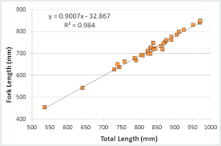
Morphometric Relationships
Length-length relationships to convert from one length type to another
Simple linear regression models with slope-intercept form:
y =mx+b
Where:
y=dependent length you
are interested in predicting
m=slope of the relationship
x=independent length you
want to convert
b=y-intercept
Typically strong
relationships with high R²

Slide 17
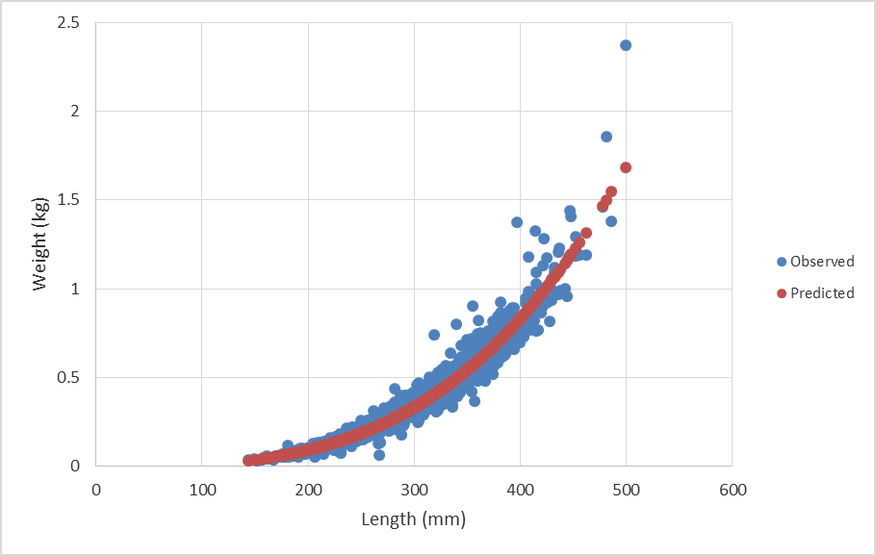


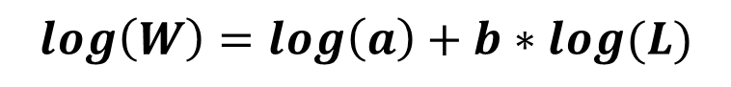
Morphometric Relationships
Length-weight relationship to convert length to weight
Can log transform to
model with a linear model:
Where:
log(W)=log transformed weight
b=slope of the relationship
log(L)=log transformed length
log(a)=y-intercept
$$W=aL^{b}$$
$$log\left(W\right)=log\left(a\right)+b∗log(L)$$
$${SPR}_{y}=\frac{\sum_{a}{{Mat}_{a}W_{a}\prod_{1}^{a}{e^{−M_{a}−F_{y,a}}}}}{\sum_{a}{{Mat}_{a}W_{a}\prod_{1}^{a}{e^{−M_{a}}}}}$$

Slide 18
Length-Weight Example
For example using Excel see the end of the intro recording for week 3 “Components of a Stock Assessment – Life History” using MLE_exercises.xls at: https://www.youtube.com/playlist?list=PL21PzNp1mlVUMu5A_Ikep5MW1tozrs2_J
For R example, open length-weight example.R

Slide 19
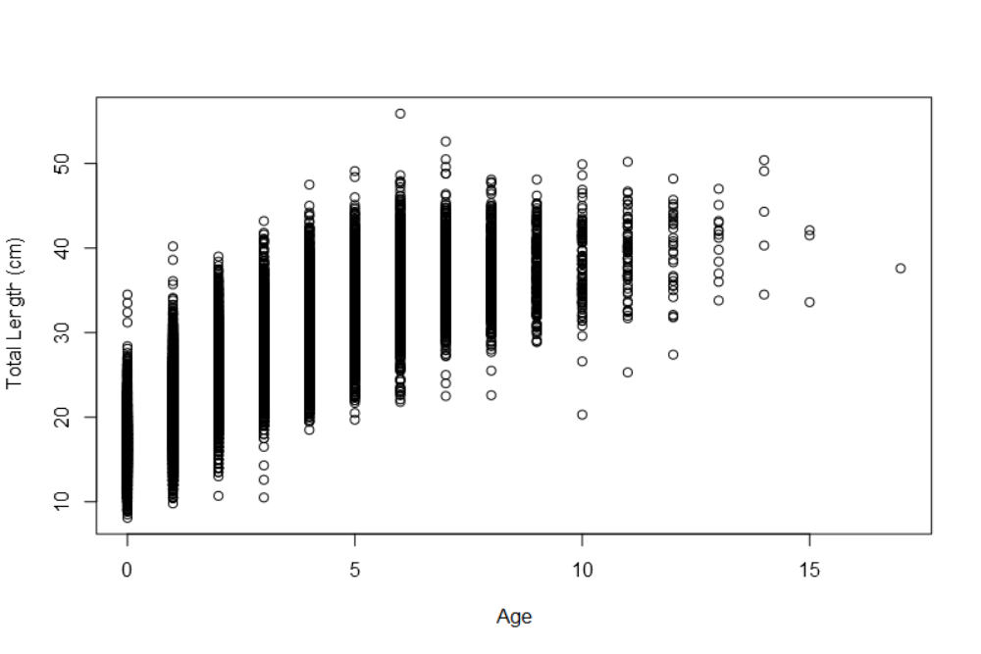

Growth
Length-at-age, weight-at-age
How does size and weight change across an individual’s life?
Fit model to
observed paired
length and age
data to predict
the mean size
at any given age
$${SPR}_{y}=\frac{\sum_{a}{{Mat}_{a}W_{a}\prod_{1}^{a}{e^{−M_{a}−F_{y,a}}}}}{\sum_{a}{{Mat}_{a}W_{a}\prod_{1}^{a}{e^{−M_{a}}}}}$$

Slide 20
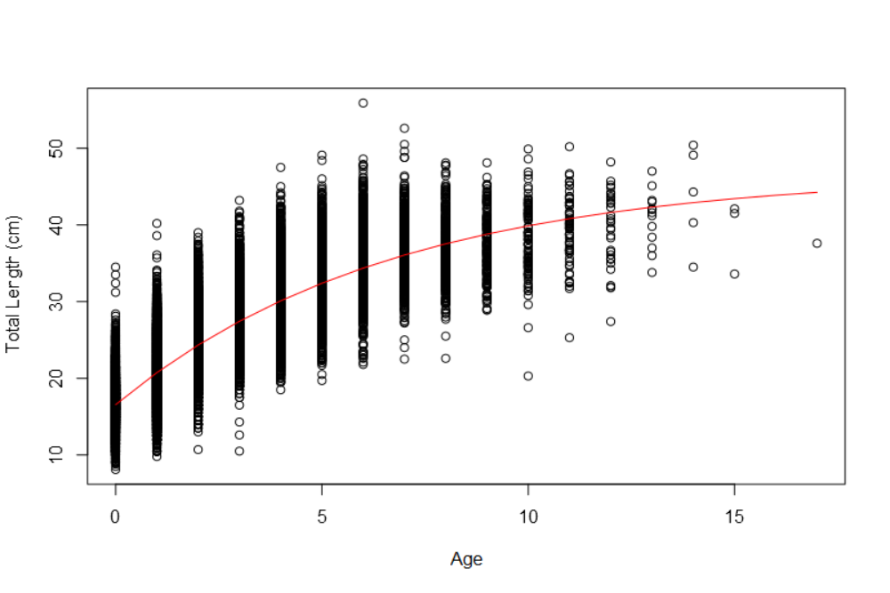
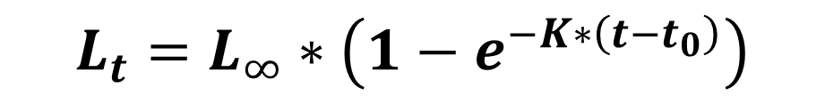
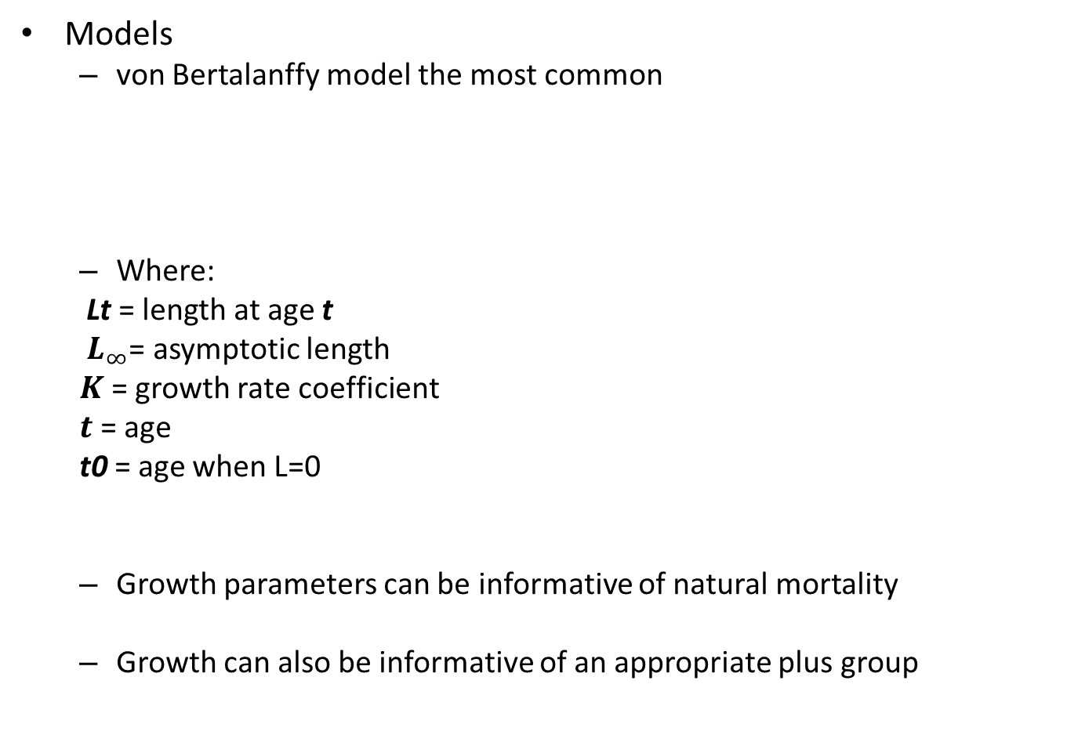
Growth
Models
von Bertalanffy model the most common
Where:
Lt = length at age t
$L_{∞}$= asymptotic length
$K$= growth rate coefficient
$t$= age
t0 = age when L=0
Growth parameters can be informative of natural mortality
Growth can also be informative of an appropriate plus group
$$L_{t}=L_{∞}∗\left(1−e^{−K∗\left(t−t_{0}\right)}\right)$$

Slide 21
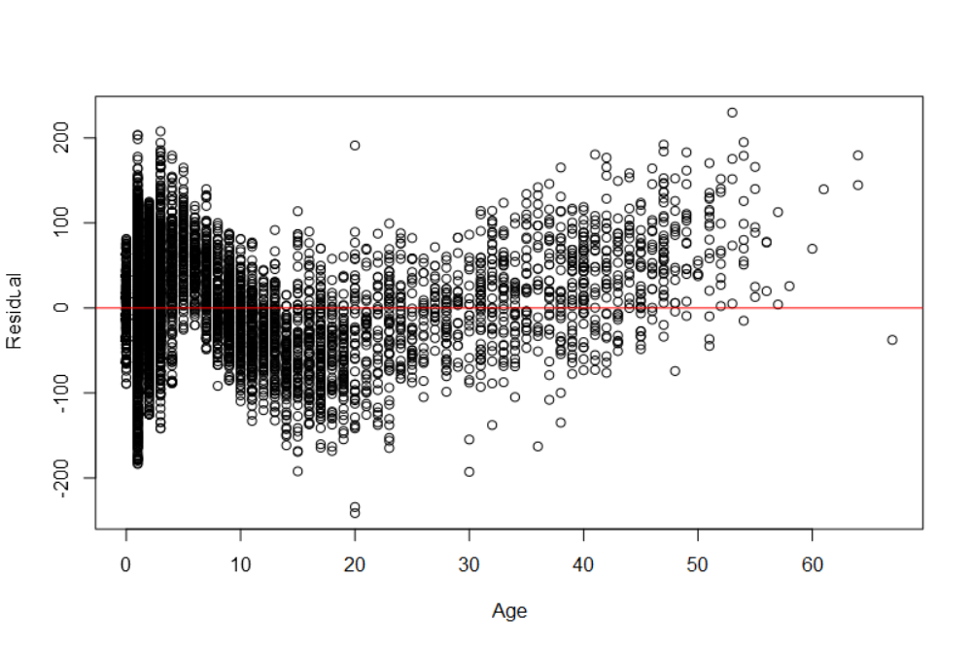
Growth
Does the growth model provide a good fit to the data? Or is there a better way to predict growth?

Slide 22
Growth
Does growth vary spatially or temporally?
Does growth vary by sex?

Slide 23
Questions?

Slide 24

Break Time Return at:

Slide 25
Growth Example
For example using Excel see the intro recording for week 2 “Intro to Modeling” using MLE_exercises.xls at: https://www.youtube.com/playlist?list=PL21PzNp1mlVUMu5A_Ikep5MW1tozrs2_J
For R example, open growth example.R

Slide 26

Maturity and Reproductive Capacity
Maturity ogive
What proportion of
individuals are mature in
each size or age class?
L₅₀ parameter informative
for size regulations
Spawning stock biomass
Maturity ogive * weight-at-age/size
Proxy for reproductive capacity
If using a spawner-per-recruit relationship in model, SSB helps you predict R
Fecundity (egg production)
$${SPR}_{y}=\frac{\sum_{a}{{Mat}_{a}W_{a}\prod_{1}^{a}{e^{−M_{a}−F_{y,a}}}}}{\sum_{a}{{Mat}_{a}W_{a}\prod_{1}^{a}{e^{−M_{a}}}}}$$

Slide 27
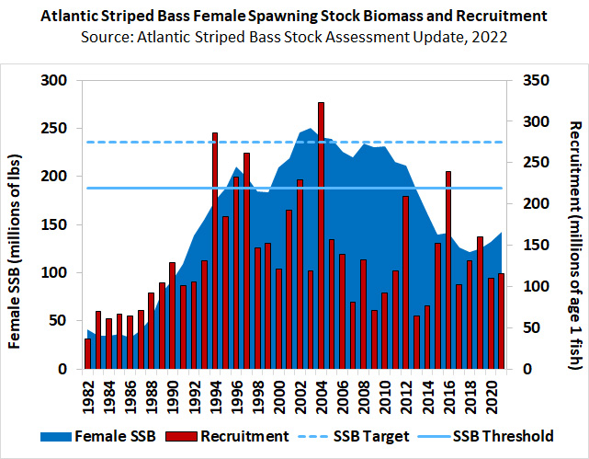
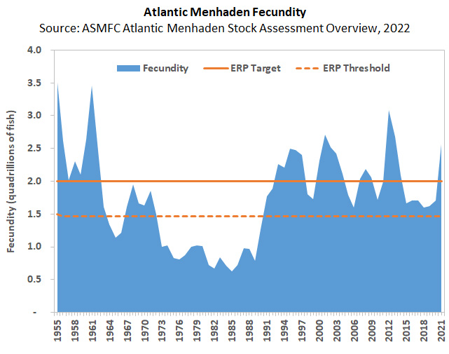
Maturity and Reproductive Capacity

Slide 28
Maturity and Reproductive Capacity
Things to consider:
Maturity at length vs. age
Does maturity trigger differences in behavior, growth, survival?
Has maturity changed over time?
Are there spatial differences in maturity schedules?
How does maturity relate to fishery regulations?
Are there sex differences in maturity schedules?
Is weight an adequate proxy for reproductive capacity?
If not, are fecundity data available?

Slide 29
Questions?

Slide 30

Natural Mortality
Natural mortality (M) = rate of death from natural causes
Predation, disease, starvation, senescence, poor environmental conditions, etc.
Trends in catch-at-age and FI surveys reflect effect of both natural and fishing mortality
Need to be able to tease apart effects of fishing to manage fisheries effectively
$${SPR}_{y}=\frac{\sum_{a}{{Mat}_{a}W_{a}\prod_{1}^{a}{e^{−M_{a}−F_{y,a}}}}}{\sum_{a}{{Mat}_{a}W_{a}\prod_{1}^{a}{e^{−M_{a}}}}}$$

Slide 31
Natural Mortality
Typically:
Difficult to estimate empirically
Estimated with meta-analyses using other life history information (e.g. maximum age)
Varies by age/length/stage
Varies over time (especially for prey species)

Slide 32
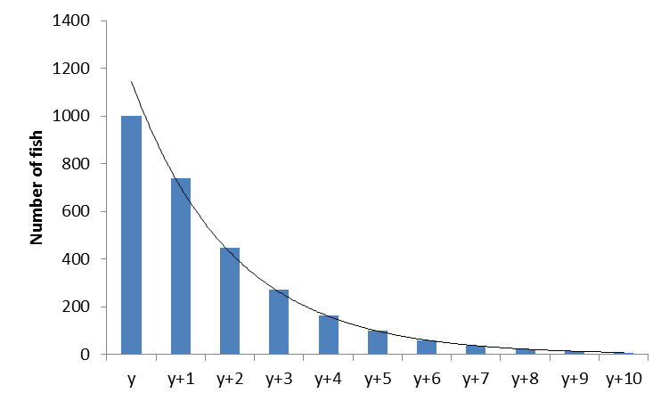
Natural Mortality
Empirical estimates of M
Track the decline of age classes in unexploited/lightly exploited populations (catch curve analysis)
Tagging studies
(dependent on good
estimates of reporting
rate)

Slide 33
Natural Mortality
Meta-analysis-based approaches
→ Open up Natural Mortality Estimators.xlsx

Slide 34
Natural Mortality
Things to consider
Can you estimate it?
Does it change with age/size and/or over time?
How are your model results affected by assumptions regarding M?
Also, think about literature, similar species, what you know…

Slide 35
Questions?

Slide 36
Stock ID
Stock = a group of individuals of the same species that behave (migrate, spawn) as a unit and are genetically identical, affected by the fishery as a unit
Is there a single coastwide stock or are there biologically distinct units within the range?
Nail this down early: it affects the rest of your data decisions and input development
Can you split the catch/index/biosample data into separate stock units?
Internationally boundaries and data availability

Slide 37
How Do You Define a Stock?
Genetic data
Tagging data
Spawning and larval transport
Other life history differences

Slide 38
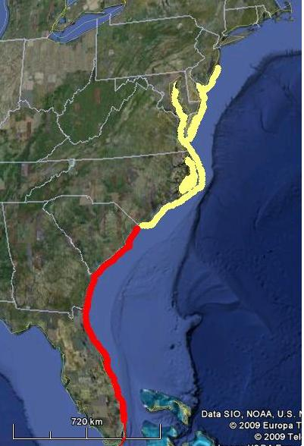
Stock ID
Red Drum
Managed & assessed as 2 separate stocks
Life history information
Max age and size differences
Tagging information
Genetics information

Slide 39
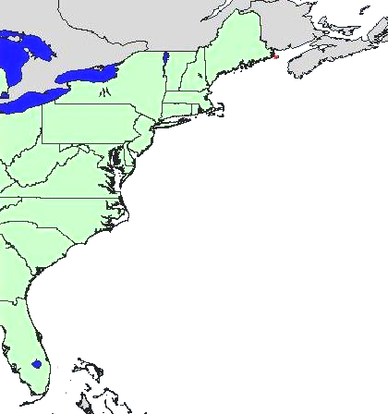
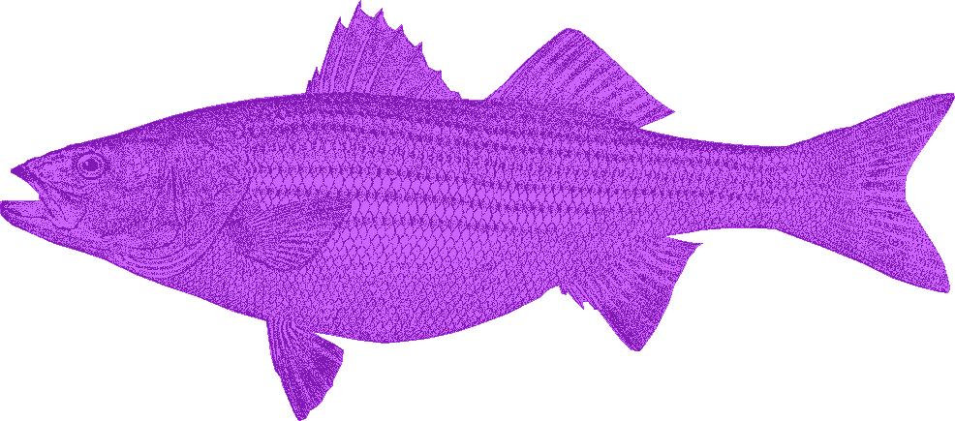
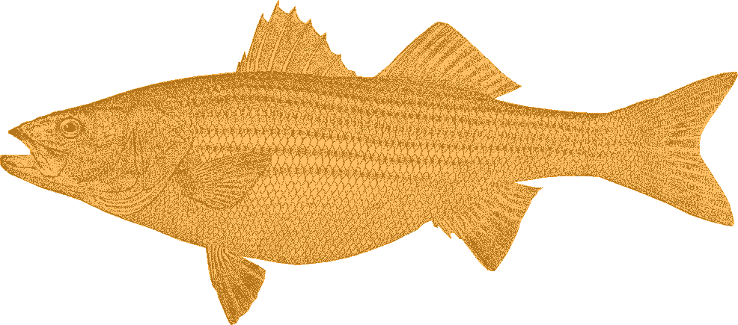
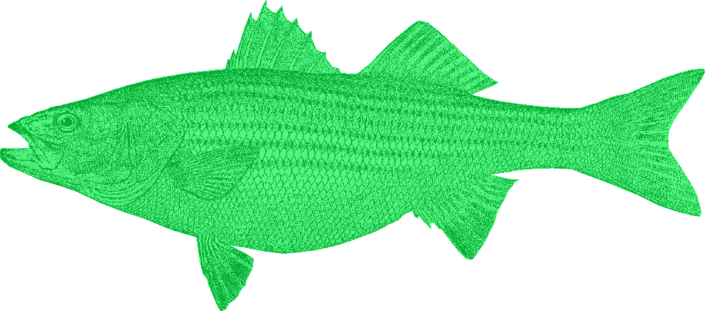
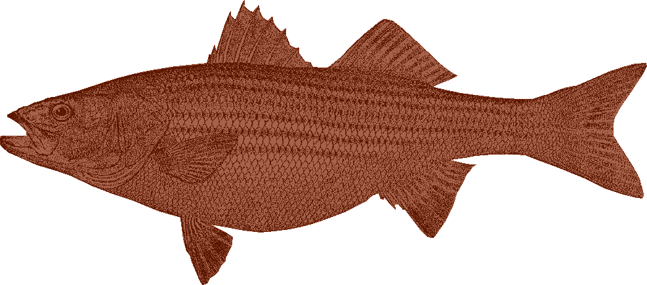
Stock ID
Striped Bass
The coastal migratory population is made up of individuals from the 3 northern stocks.
Based on historical tagging data, Albermarle-Roanoke fish do not join the coastal migratory population.

Slide 40
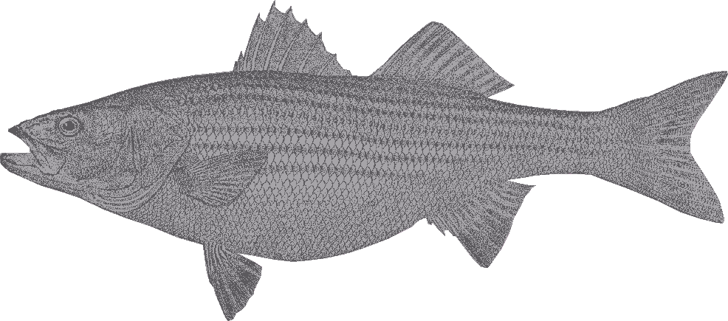
Stock ID
However, we can’t ID the individual stock components of the ocean catch
→ Manage & assess as a single stock

Slide 41
Stock ID
Is there tagging/genetic/spawning evidence to support a unit stock?
Do you have the data to assess the entire stock? If not, reconsider or caveat your conclusions!
How serious are substock dynamics relative to model assumptions?
Unless your model includes migration, it assumes your stock is homogeneous

Slide 42
Questions?

Slide 43
Life History: Project
Project and working session next week….
Calculate length-weight relationship and size-at-age for 2015. Evaluate spatial or seasonal differences in growth.
Develop estimates of M using more than one method. Compare the results and recommend a preferred method.
Give these a try using the examples provided or your own code and bring questions next week

Slide 44
Group Assignments
Life History: L-W, Size-at-Age
(Life History Q1)
Margaret Conroy
Brendan Harrison
CJ Schlick
Holly White
Caitlin Craig
Life History: M
(Life History Q2)
Daniel Sasson
Shelby White
Tara Dolan
Michaela Pawluk
Tori Kentner
Age-Length Keys
(Catch Q1)
Jes Waller
Heather Christiansen
Brooke Lowman
Rich Pendleton
Conor O’Donnell
2015 CAA
(Catch Q2 & Q3)
Eddie Leonard
Judd Curtis
Matthew Jargowsky
Ryan Harrell
Tyler Grabowski
FD Index
(Indices Q1 & Q2)
Alexa Galvan
Kelli Mosca
Lulu Bates
Corey Pelletier
Somers Smott
FI Index
(Indices Q1 & Q2)
Chad Power
Julia Livermore
Jimmy Kilfoil
Ana Vaz
Corinne Truesdale
Halie O’Farrell

Slide 45
Questions?

